Slide 1
CSC 2224: Parallel Computer Architecture and Programming Caches and Main Memory
Prof. Gennady Pekhimenko
University of Toronto
Fall 2022
The content of this lecture is adapted from the lectures of
Onur Mutlu @ CMU and ETH

Slide 2
What’s In A Tag Store Entry?
Valid bit
Tag
Replacement policy bits
Dirty bit?
Write back vs. write through caches

Slide 3
Handling Writes (I)
When do we write the modified data in a cache to the next level?
Write through: At the time the write happens
Write back: When the block is evicted
Write-back
+ Can combine multiple writes to the same block before eviction
Potentially saves bandwidth between cache levels + saves energy
-- Need a bit in the tag store indicating the block is “dirty/modified”
Write-through
+ Simpler
+ All levels are up to date. Consistency: Simpler cache coherence because no need to check close-to-processor caches’ tag stores for presence
-- More bandwidth intensive; no combining of writes

Slide 4
Handling Writes (II)
Do we allocate a cache block on a write miss?
Allocate on write miss: Yes
No-allocate on write miss: No
Allocate on write miss
+ Can combine writes instead of writing each of them individually to next level
+ Simpler because write misses can be treated the same way as read misses
-- Requires (?) transfer of the whole cache block
No-allocate
+ Conserves cache space if locality of writes is low (potentially better cache hit rate)

Slide 5
Handling Writes (III)
What if the processor writes to an entire block over a small amount of time?
Is there any need to bring the block into the cache from memory in the first place?
Ditto for a portion of the block, i.e., subblock
E.g., 4 bytes out of 64 bytes

Slide 6
Cache Performance

Slide 7
Cache Parameters vs. Miss/Hit Rate
Cache size
Block size
Associativity
Replacement policy
Insertion/Placement policy

Slide 8
Cache Size
Cache size: total data (not including tag) capacity
bigger can exploit temporal locality better
not ALWAYS better
Too large a cache adversely affects hit and miss latency
smaller is faster => bigger is slower
access time may degrade critical path
Too small a cache
doesn’t exploit temporal locality well
useful data replaced often
Working set: the whole set of data the executing application references
Within a time interval
hit rate
“working set”
size
cache size

Slide 9
Block Size
Block size is the data that is associated with an address tag
not necessarily the unit of transfer between hierarchies
Sub-blocking: A block divided into multiple pieces (each with V bit)
Can improve “write” performance
Too small blocks
don’t exploit spatial locality well
have larger tag overhead
Too large blocks
too few total # of blocks → less
temporal locality exploitation
waste of cache space and
bandwidth/energy:
if spatial locality is not high
hit rate
block
size

Slide 10
Large Blocks: Critical-Word and Subblocking
Large cache blocks can take a long time to fill into the cache
fill cache line critical word first
restart cache access before complete fill
Large cache blocks can waste bus bandwidth
divide a block into subblocks
associate separate valid bits for each subblock
When is this useful?
subblock
v
d
subblock
v
d
subblock
v
d
tag

Slide 11
Associativity
How many blocks can be present in the same index (i.e., set)?
Larger associativity
lower miss rate (reduced conflicts)
higher hit latency and area cost (plus diminishing returns)
Smaller associativity
lower cost
lower hit latency
Especially important for L1 caches
Is power of 2 associativity required?
hit rate
associativity

Slide 12
Classification of Cache Misses
Compulsory miss
first reference to an address (block) always results in a miss
subsequent references should hit unless the cache block is displaced for the reasons below
Capacity miss
cache is too small to hold everything needed
defined as the misses that would occur even in a fully-associative cache (with optimal replacement) of the same capacity
Conflict miss
defined as any miss that is neither a compulsory nor a capacity miss

Slide 13
How to Reduce Each Miss Type
Compulsory
Caching cannot help
Prefetching can
Conflict
More associativity
Other ways to get more associativity without making the cache associative
Victim cache
Better, randomized indexing
Software hints?
Capacity
Utilize cache space better: keep blocks that will be referenced
Software management: divide working set such that each “phase” fits in cache

Slide 14
How to Improve Cache Performance
Three fundamental goals
Reducing miss rate
Caveat: reducing miss rate can reduce performance if more costly-to-refetch blocks are evicted
Reducing miss latency or miss cost
Reducing hit latency or hit cost
The above three together affect performance

Slide 15
Improving Basic Cache Performance
Reducing miss rate
More associativity
Alternatives/enhancements to associativity
Victim caches, hashing, pseudo-associativity, skewed associativity
Better replacement/insertion policies
Software approaches
Reducing miss latency/cost
Multi-level caches
Critical word first
Subblocking/sectoring
Better replacement/insertion policies
Non-blocking caches (multiple cache misses in parallel)
Multiple accesses per cycle
Software approaches

Slide 16
Cheap Ways of Reducing Conflict Misses
Instead of building highly-associative caches:
Victim Caches
Hashed/randomized Index Functions
Pseudo Associativity
Skewed Associative Caches
…

Slide 17
Victim Cache: Reducing Conflict Misses
Jouppi, “Improving Direct-Mapped Cache Performance by the Addition of a Small Fully-Associative Cache and Prefetch Buffers,” ISCA 1990.
Idea: Use a small fully-associative buffer (victim cache) to store recently evicted blocks
+ Can avoid ping ponging of cache blocks mapped to the same set (if two cache blocks continuously accessed in nearby time conflict with each other)
-- Increases miss latency if accessed serially with L2; adds complexity
Victim cache
Direct Mapped Cache
Next Level
Cache

Slide 18
Hashing and Pseudo-Associativity
Hashing: Use better “randomizing” index functions
+ can reduce conflict misses
by distributing the accessed memory blocks more evenly to sets
Example of conflicting accesses: strided access pattern where stride value equals number of sets in cache
-- More complex to implement: can lengthen critical path
Pseudo-associativity (Poor Man’s associative cache)
Serial lookup: On a miss, use a different index function and access cache again
Given a direct-mapped array with K cache blocks
Implement K/N sets
Given address Addr, sequentially look up: {0,Addr[lg(K/N)-1: 0]}, {1,Addr[lg(K/N)-1: 0]}, … , {N-1,Addr[lg(K/N)-1: 0]}
+ Less complex than N-way; -- Longer cache hit/miss latency

Slide 19
Skewed Associative Caches
Idea: Reduce conflict misses by using different index functions for each cache way
Seznec, “A Case for Two-Way Skewed-Associative Caches,” ISCA 1993.

Slide 20
Skewed Associative Caches (I)
Basic 2-way associative cache structure
Way 0
Way 1
Same index function
for each way
=?
=?
Tag Index Byte in Block

Slide 21
Skewed Associative Caches (II)
Skewed associative caches
Each bank has a different index function
same index
redistributed to
different sets
same index
same set
Way 0
Way 1
f0
=?
tag index byte in block
=?

Slide 22
Skewed Associative Caches (III)
Idea: Reduce conflict misses by using different index functions for each cache way
Benefit: indices are more randomized (memory blocks are better distributed across sets)
Less likely two blocks have same index (esp. with strided access)
Reduced conflict misses
Cost: additional latency of hash function

Slide 23
Software Approaches for Higher Hit Rate
Restructuring data access patterns
Restructuring data layout
Loop interchange
Data structure separation/merging
Blocking
…

Slide 24
Restructuring Data Access Patterns (I)
Idea: Restructure data layout or data access patterns
Example: If column-major
x[i+1,j] follows x[i,j] in memory
x[i,j+1] is far away from x[i,j]
This is called loop interchange
Other optimizations can also increase hit rate
Loop fusion, array merging, …
What if multiple arrays? Unknown array size at compile time?
Poor code
for i = 1, rows
for j = 1, columns
sum = sum + x[i,j]
Better code
for j = 1, columns
for i = 1, rows
sum = sum + x[i,j]

Slide 25
Restructuring Data Access Patterns (II)
Blocking
Divide loops operating on arrays into computation chunks so that each chunk can hold its data in the cache
Avoids cache conflicts between different chunks of computation
Essentially: Divide the working set so that each piece fits in the cache
But, there are still self-conflicts in a block
1. there can be conflicts among different arrays
2. array sizes may be unknown at compile/programming time

Slide 26
Restructuring Data Layout (I)
Pointer based traversal (e.g., of a linked list)
Assume a huge linked list (1B nodes) and unique keys
Why does the code on the left have poor cache hit rate?
“Other fields” occupy most of the cache line even though rarely accessed!
struct Node {
struct Node* next;
int key;
char [256] name;
char [256] school;
}
while (node) {
if (node→key == input-key) {
// access other fields of node
}
node = node→next;
}

Slide 27
Restructuring Data Layout (II)
struct Node {
struct Node* next;
int key;
struct Node-data* node-data;
}
struct Node-data {
char [256] name;
char [256] school;
}
while (node) {
if (node→key == input-key) {
// access node→node-data
}
node = node→next;
}
Idea: separate frequently-used fields of a data structure and pack them into a separate data structure
Who should do this?
Programmer
Compiler
Profiling vs. dynamic
Hardware?
Who can determine what is frequently used?

Slide 28
Improving Basic Cache Performance
Reducing miss rate
More associativity
Alternatives/enhancements to associativity
Victim caches, hashing, pseudo-associativity, skewed associativity
Better replacement/insertion policies
Software approaches
Reducing miss latency/cost
Multi-level caches
Critical word first
Subblocking/sectoring
Better replacement/insertion policies
Non-blocking caches (multiple cache misses in parallel)
Multiple accesses per cycle
Software approaches

Slide 29
Miss Latency/Cost
What is miss latency or miss cost affected by?
Where does the miss get serviced from?
Local vs. remote memory
What level of cache in the hierarchy?
Row hit versus row miss in DRAM
Queueing delays in the memory controller and the interconnect
…
How much does the miss stall the processor?
Is it overlapped with other latencies?
Is the data immediately needed?
…

Slide 30
Memory Level Parallelism (MLP)
isolated miss
parallel miss
B
A
C
time
Memory Level Parallelism (MLP) means generating and servicing multiple memory accesses in parallel [Glew’98]
Several techniques to improve MLP (e.g., out-of-order execution)
MLP varies. Some misses are isolated and some parallel
How does this affect cache replacement?
Notes:
Processors are fast, Memory is slow. One way to bridge this gap is to service the memory accesses in parallel. If misses are serviced in parallel, the processor incurs only one long latency stall for all the parallel misses. The notion of generating and servicing off-chip accesses in parallel is termed as Memory Level Parallelism or MLP. Out of order processors improve MLP by continuing processing of independent instructions till the instruction window is full. If there is a miss during the processing of independent instructions, the miss is serviced concurrently with the stalling miss. There are several techniques, such as Runahead, CFP, to improve the MLP of out-of-order processors. MLP is not uniform for all cache misses. Some misses, such as pointer chasing loads, are typically serviced with low MLP while other misses, such as array accesses are serviced with high MLP. Current cache management techniques are not aware of this variation in MLP.

Slide 31
Traditional Cache Replacement Policies
Traditional cache replacement policies try to reduce miss count
Implicit assumption: Reducing miss count reduces memory-related stall time
Misses with varying cost/MLP breaks this assumption!
Eliminating an isolated miss helps performance more than eliminating a parallel miss
Eliminating a higher-latency miss could help performance more than eliminating a lower-latency miss

Slide 32
An Example
P4 P3 P2 P1
P1 P2 P3 P4
S1
S2
S3
Misses to blocks P1, P2, P3, P4 can be parallel
Misses to blocks S1, S2, and S3 are isolated
Two replacement algorithms:
Minimizes miss count (Belady’s OPT)
Reduces isolated miss (MLP-Aware)
For a fully associative cache containing 4 blocks
Notes:
There are 11 memory access instructions in the loop. The accesses to cache blocks P1, P2, P3, P4 occur in the instruction window at same time. If these accesses result in more than 1 miss, then those misses are serviced in parallel. Conversely, misses to the S blocks are spaced far apart in time to misses to the S blocks are always serviced in isolation. This loop executes many time. I will analyze the cache behavior of this loop for two replacement algorithms. The first minimizes the number of misses. The well known Belady's opt algorithm provides a theoretical lower bound on the number of misses. The other is MLP-aware replacement, which tries to reduce the number of isolated miss.

Slide 33
Fewest Misses = Best Performance
P4
Cache
P4
P3
S1
P2
S2
S3
S3
P4
P1
P3
S1
P2
S2
P1
S3
P4
P4
P3
S1
P4
P2
S2
P3
P1
S3
P2
P4
S1
P3
P2
P4
S2
P3
P2
S3
P4 P3 P2 P1
P1 P2 P3 P4
S1
S2
S3
Hit/Miss
H H H M
H H H H
M
M
M
Misses=4 Stalls=4
Time
stall
Belady’s OPT replacement
Hit/Miss
H M M M
H M M M
H H H
Saved cycles
Misses=6Stalls=2
Time
stall
MLP-Aware replacement
Notes:
Although Belady’s OPT minimizes misses, it is impossible to implement it in a real processor as it requires knowledge of the future. We employ the commonly used LRU policy in our experiments

Slide 34
MLP-Aware Cache Replacement
How do we incorporate MLP into replacement decisions?
Qureshi et al., “A Case for MLP-Aware Cache Replacement,” ISCA 2006.

Slide 35
CSC 2224: Parallel Computer Architecture and Programming Main Memory Fundamentals
Prof. Gennady Pekhimenko
University of Toronto
Fall 2022
The content of this lecture is adapted from the slides of
Vivek Seshadri, Donghyuk Lee, Yoongu Kim,
and lectures of Onur Mutlu @ ETH and CMU

Slide 36
Review #4
RowClone: Fast and Energy-Efficient In-DRAM Bulk Data Copy and Initialization Vivek Seshadri et al., MICRO 2013

Slide 37
Why Is Memory So Important? (Especially Today)

Slide 38
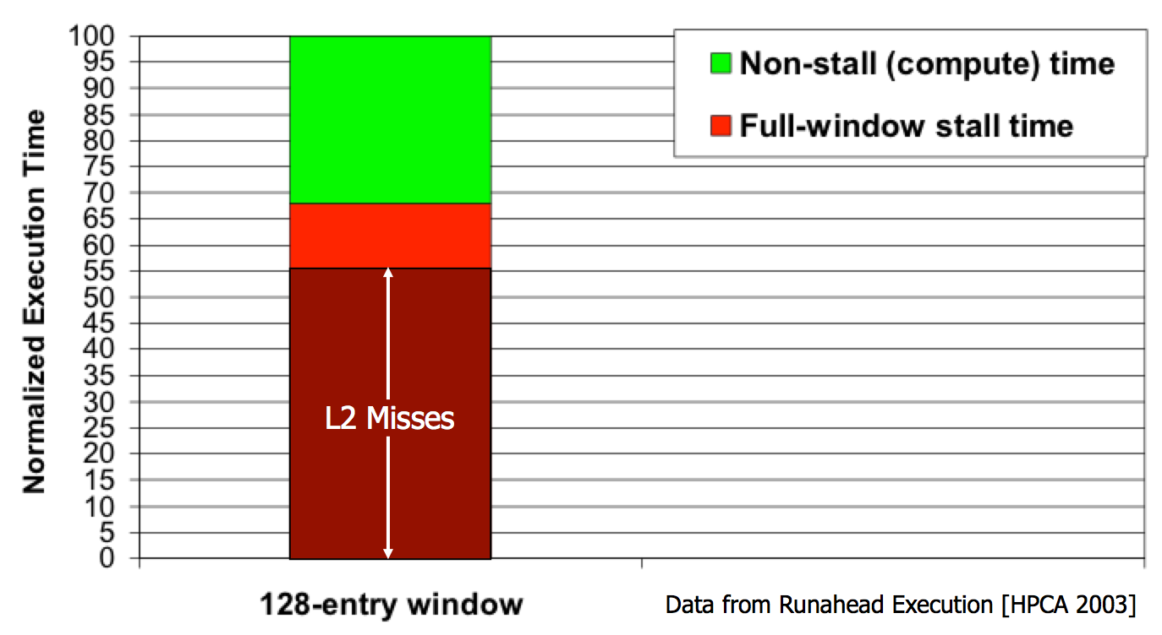
The Performance Perspective
“It’s the Memory, Stupid!” (Richard Sites, MPR, 1996)
Mutlu+, “Runahead Execution: An Alternative to Very Large Instruction Windows for Out-of-Order Processors,” HPCA 2003.

Slide 39
The Energy Perspective
Dally, HiPEAC 2015

Slide 40
The Energy Perspective
Dally, HiPEAC 2015
A memory access consumes ~1000X
the energy of a complex addition

Slide 41
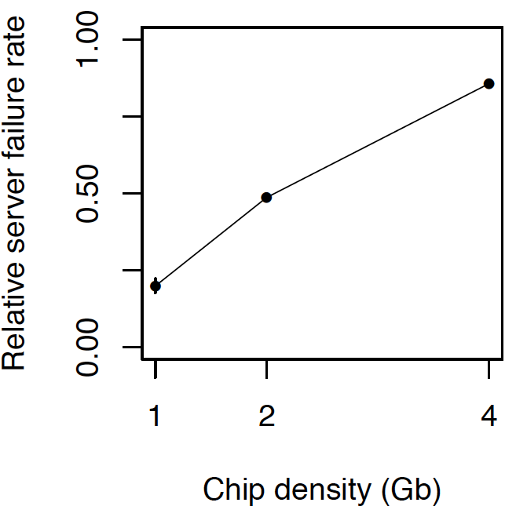
The Reliability Perspective
Data from all of Facebook’s servers worldwide
Meza+, “Revisiting Memory Errors in Large-Scale Production Data Centers,” DSN’15.
Intuition: quadratic increase in capacity

Slide 42
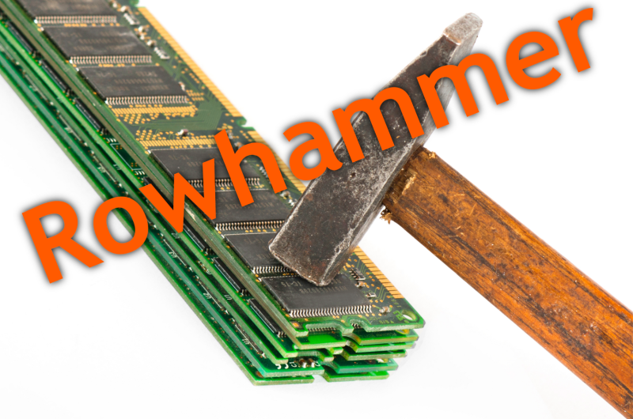
The Security Perspective
Notes:
Picture from the article:
http://thehackernews.com/2015/03/dram-rowhammer-vulnerability.html

Slide 43
Why Is DRAM So Slow?

Slide 44
Motivation (by Vivek Seshadri)
Conversation with a friend from Stanford
Why is DRAM so slow?!
Really?
50 nanoseconds to serve one request? Is that a fundamental limit to DRAM’s access latency?
Him
Vivek

Slide 45
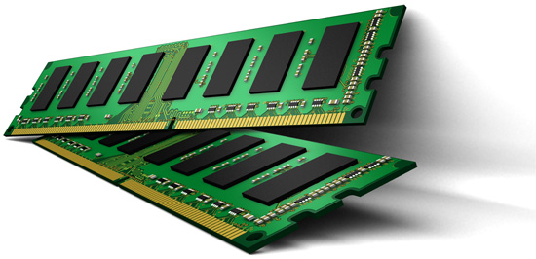
Understanding DRAM
What is in here?
DRAM
Problems related to today’s DRAM design
Solutions proposed by our research

Slide 46
Outline
What is DRAM?
DRAM Internal Organization
Problems and Solutions
Latency (Tiered-Latency DRAM, HPCA 2013, Adaptive-Latency DRAM, HPCA 2015)
Parallelism (Subarray-level Parallelism, ISCA 2012)

Slide 47
What is DRAM?
DRAM – Dynamic Random Access Memory
Array of Values
READ address
3455434
43543
WRITE address, value
98734
Accessing any location takes the same amount of time
0
847
42
Data needs to be constantly refreshed
873909
1729
Notes:
DRAM stands for Dynamic Random Access Memory.
Memory, as many of may know, is a device that can store information and allow the information to be retrieved at a later point in time. The simplest abstraction for memory is an array of fixed-size values. We can read from a location by specifying its address or write to a location by providing its address and the value to be written.
A random access memory is one in which accessing any location takes the same amount of time.
The dynamic part of DRAM refers to the fact that DRAM loses data when left alone.

Slide 48
DRAM in Today’s Systems
Why DRAM? Why not some other memory?
Notes:
DRAM memory is an integral part of most computing systems today. Desktops, laptops, mobile phones, large servers; all of them have DRAM based memory.
In fact, if you ever wondered why your laptops have a separate sleep mode and hibernate mode, the dynamic part of DRAM is one of the primary reasons. In the sleep mode, the DRAM in your laptop is still powered on and kept in a state where it does not lose its data. In the hibernate mode, the data in DRAM is written to the hard disk and the system is completely shutdown.
Why DRAM? Why not some other memory?

Slide 49
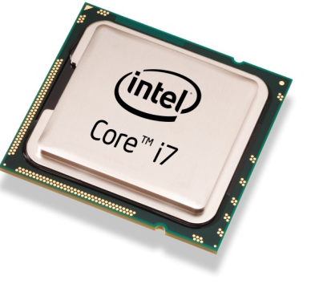
Von Neumann Model
Processor
Memory
Program
Data
4 instruction accesses +
3 data accesses
T1 = Read Data[1]
T1 = Read Data[1]
3
T2 = Read Data[2]
4
4
T3 = T1 + T2
8
Write Data[3], T3
2
Memory performance is important

Slide 50
Factors that Affect Choice of Memory
Speed
Should be reasonably fast compared to processor
Capacity
Should be large enough to fit programs and data
Cost
Should be cheap
Notes:
There are three factors that affect the choice of memory in a system.
Speed, Capacity and Cost. Blah..
In fact, as we will see in this talk, cost is one of the primary factors that drives decisions taken by the industry.

Slide 51
Why DRAM?
Flip-flops
Higher Cost
Favorable point in the trade-off spectrum
SRAM
Cost
DRAM
Higher access latency
Disk
Flash
Access Latency
Notes:
In contrast, DRAM is at a favorable point in this trade-off spectrum between cost and latency. And it is going to remain so for the foreseeable future.

Slide 52
Is DRAM Fast Enough?
Processor
Commodity DRAM
Core
Core
Core
Core
Latency
3 GHz, 2 Instructions / cycle
50ns
300 Instructions
Parallelism
Request
300 Instructions
Request
300 Instructions
Request
300 Instructions
Request
Independent programs
Served in parallel?
Notes:
Is DRAM fast enough? Let us try to understand this using today’s processor and DRAM technology. The DRAM we can buy today, which I will refer to as commodity DRAM, takes 50ns to serve a request. A modern processor running at 3Ghz and executing 2 instructions every cycle can run up to 300 instructions in the same duration. To make matters worse, modern processors have multiple cores which can independently execute different programs. If each of these programs independently generate memory requests, the question is whether DRAM can serve the requests in parallel? If the independent requests are served serially, then the cores will have to wait for much longer before doing any useful work. So, there are two problems related to DRAM that we need to address: Latency and Parallelism.

Slide 53
Outline
What is DRAM?
DRAM Internal Organization
Problems and Solutions
Latency (Tiered-Latency DRAM, HPCA 2013, Adaptive-Latency DRAM, HPCA 2015)
Parallelism (Subarray-level Parallelism, ISCA 2012)

Slide 54
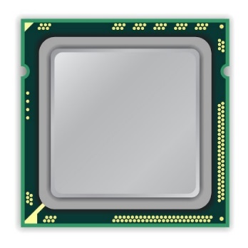
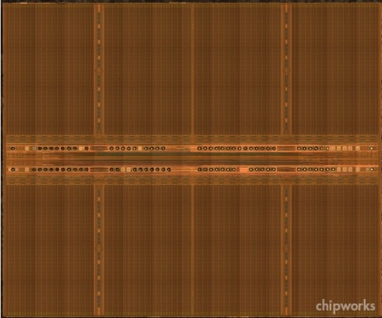
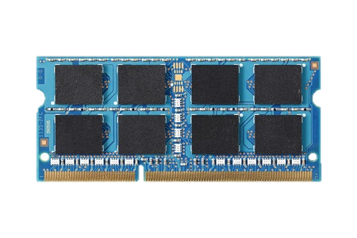
DRAM Organization
mat
processor
peripheral logic
bank
main memory
high latency
Notes:
Right figure shows the picture of real DRAM chip,
which consists of multiple banks and peripheral logic for accessing cells in banks.
Each bank is subdivided into multiple mats.

Slide 55
DRAM Cell Array: Mat
mat
bitline
mat
cell
peripheral logic
cell
wordline driver
wordline
sense amplifier
Notes:
A mat consists of 2d cell array.
The cells are horizontally connected to wordline driver by wordline,
and vertically connected to a sense amplifier by bitline.

Slide 56
Memory Element (Cell)
Component that can be in at least two states
0
1
Can be electrical, magnetic, mechanical, etc.
DRAM → Capacitor

Slide 57
Capacitor – Bucket of Electric Charge
“Charged”
“Discharged”
V_{max}
Voltage level indicator. Not part of the actual circuit
0
0
0
Charge

Slide 58
DRAM Chip
DRAM Chip
Contains billions of capacitors (also called cells)
?
0

Slide 59
Divide and Conquer
DRAM Bank
?
Challenges
Weak
Reading destroys state

Slide 60
Sense-Amplifier
V_{max}
V_{x}+δ
V_{x}
V_{x}+δ
V_{x}
Amplify the difference
V_{x} > V_{y}
Stable state
V_{y}
0
V_{y}-δ
V_{y}

Slide 61
Outline
What is DRAM?
DRAM Internal Organization
DRAM Cell
DRAM Array
DRAM Bank
Problems and Solutions
Latency (Tiered-Latency DRAM, HPCA 2013)
Parallelism (Subarray-level Parallelism, ISCA 2012)

Slide 62
DRAM Cell Read Operation
V_{max}
V_{max}
V_{max}/2 + δ
V_{max}/2
V_{max}/2 + δ
DRAM
Cell
0
Amplify the difference
Restore Cell Data
Cell loses charge
Access data
2
Sense-Amplifier
1
V_{max}/2
0

Slide 63
DRAM Cell Read Operation
Control Signal
Address
DRAM
Cell
DRAM
Cell
0
Sense-Amplifier

Slide 64
Outline
What is DRAM?
DRAM Internal Organization
DRAM Cell
DRAM Array
DRAM Bank
Problems and Solutions
Latency (Tiered-Latency DRAM, HPCA 2013; Adaptive-Latency DRAM, HPCA 2015)
Parallelism (Subarray-level Parallelism, ISCA 2012)

Slide 65
Problem
Control Signal
Address
DRAM
Cell
Much larger than a cell
Sense-Amplifier

Slide 66
Cost Amortization
Bitline
Wordline

Slide 67
DRAM Array Operation
n
Restore
Sense-Amplifier
Wordline Disable
Sensing & Amplification
Charge Restoration
Row Decoder
Charge Sharing
Wordline Enable
m
m
1
?
0
?
0
?
1
?
1
?
0
?
1
1
?
0
?
0
?
1
?
0
?
1
Row Address
?
½
↑½
1
½
½↓
0
½
½↓
0
½
↑½
1
½
↑½
1
½
½↓
0
½
↑½
1
½
½↓
0
½
½↓
0
½
↑½
1
½
½↓
0
½
↑½
1
Sense-Amplifiers
Access Data (column n)

Slide 68
Outline
What is DRAM?
DRAM Internal Organization
DRAM Cell
DRAM Array
DRAM Bank
Problems and Solutions
Latency (Tiered-Latency DRAM, HPCA 2013 Adaptive-Latency DRAM, HPCA 2015)
Parallelism (Subarray-level Parallelism, ISCA 2012)

Slide 69
DRAM Bank
How to build a DRAM bank from a DRAM array?

Slide 70
DRAM Bank: Single DRAM Array?
Long bitline
Difficult to sense data in far away cells
Row Decoder
1
0
0
1
1
0
0
1
Row Address
10000+ rows

Slide 71
DRAM Bank: Collection of Arrays
Row Decoder
1
0
0
1
1
0
0
1
Subarray
Row Decoder
Data
Row Address
Column Read/Write

Slide 72
DRAM Operation: Summary
Row Decoder
1
0
0
1
1
0
0
1
Row Decoder
Row m, Col n
1. Enable row m
2. Access col n
3. Close row
m
Row Address
Column Read/Write
m
n

Slide 73
DRAM Chip Hierarchy
Collection of Banks
Row Decoder
1
0
0
1
1
0
0
1
Row Decoder
Row Address
Column Read/Write
Collection of Subarrays

Slide 74
Outline
What is DRAM?
DRAM Internal Organization
Problems and Solutions
Latency (Tiered-Latency DRAM, HPCA 2013; Adaptive-Latency DRAM, HPCA 2015)
Parallelism (Subarray-level Parallelism, ISCA 2012)

Slide 75
Review #4
RowClone: Fast and Energy-Efficient In-DRAM Bulk Data Copy and Initialization Vivek Seshadri et al., MICRO 2013

Slide 76
CSC 2224: Parallel Computer Architecture and Programming Main Memory Fundamentals
Prof. Gennady Pekhimenko
University of Toronto
Fall 2022
The content of this lecture is adapted from the slides of
Vivek Seshadri, Donghyuk Lee, Yoongu Kim,
and lectures of Onur Mutlu @ ETH and CMU

